Slide 1
Simple Shapes

Slide 2
How are simple shapes made?
1. With a Line

Slide 3
2. With Color

Slide 4
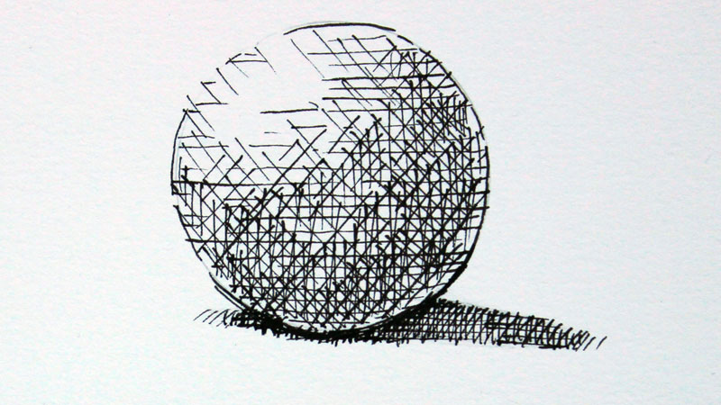
3. With Value and Texture

Slide 5
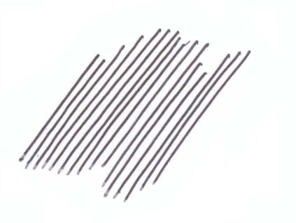
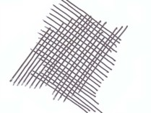
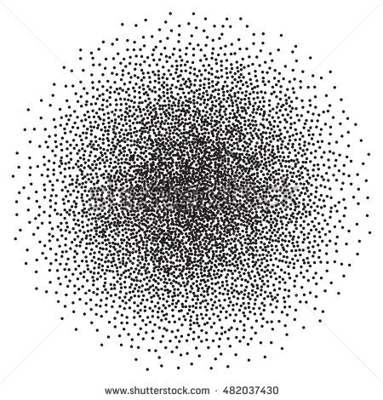
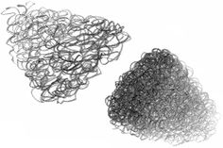
4 ways to create texture
Hatching
Cross Hatching
Stippling
Scumbling

Slide 6
Let’s get creative!

Slide 7
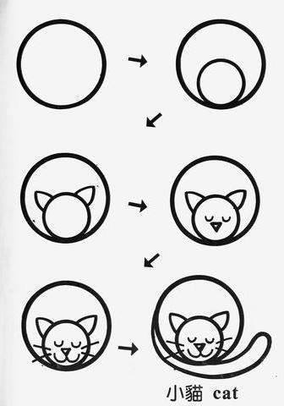

Slide 8
