Slide 1
Regular Mandala Examples

Slide 3
Personal Mandala Examples

Slide 4
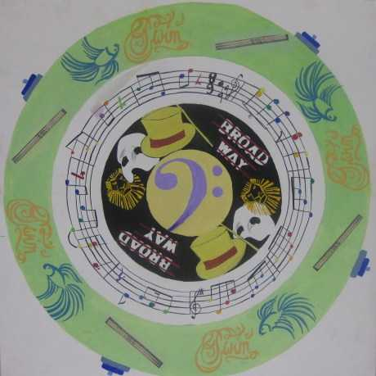

Slide 5
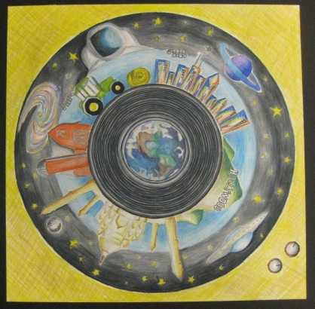

Slide 6
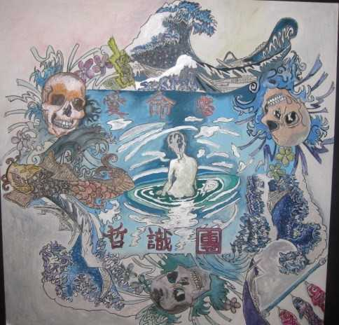

Slide 8
